Slide 1



Multimedia & Graphics
Class VI
lab 19

Slide 2
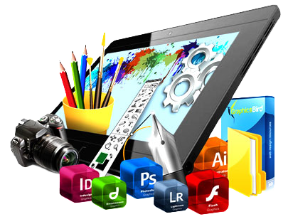

Editing Photo
Go to befunky and
upload an image
you want to edit

Slide 3
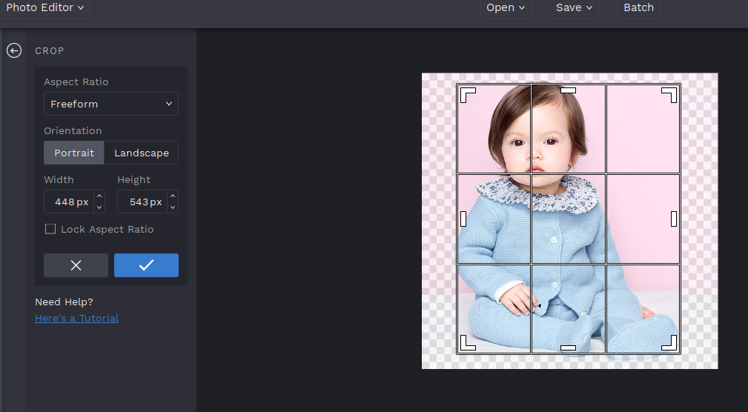
Crop an Image
you can customise
the ratio of your image
by croping

Slide 4
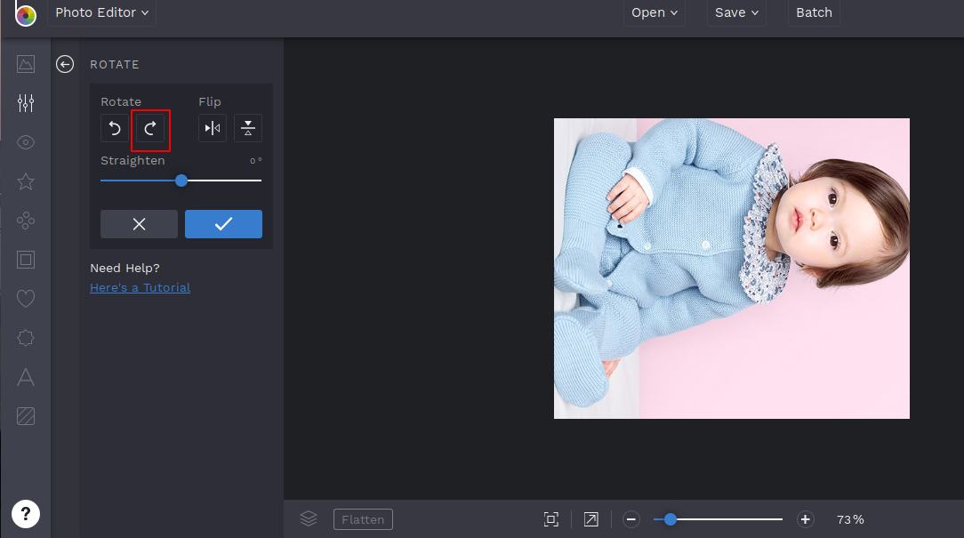
Rotate an Image
rotating an image is so
easy with befunky

Slide 5
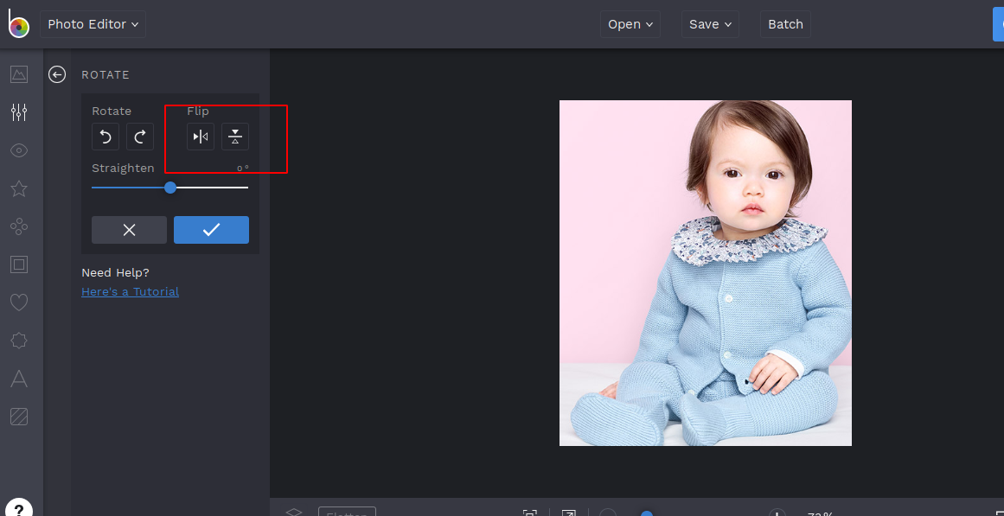
FLip Image
you can reverse your image
by flipping

Slide 6
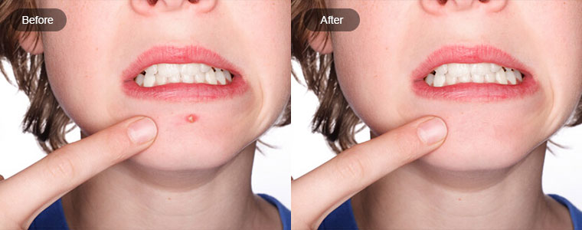
Beautify Image
you can makeup and
makeover by
beautifying your image

Slide 7
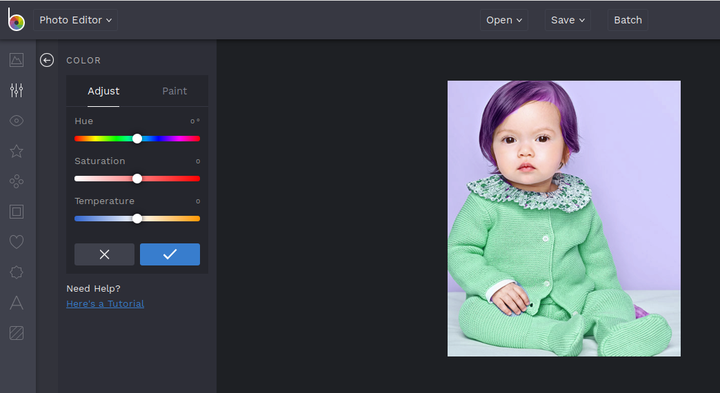
Coloring an Image
you can change the
color of any specific
part of your image

Slide 8



